Slide 1

G2M Case Study: Cab Investment Firm
Data Glacier Virtual Internship
9/16/2023

Slide 2

Agenda
Background of Case Study
Understanding the Data
EDA
EDA Summary
Recommendations

Slide 3
Background of Case Study
XYZ is a private firm in US. Due to remarkable growth in the Cab Industry in last few years and multiple key players in the market, it is planning for an investment in Cab industry and as per their Go-to-Market(G2M) strategy they want to understand the market before taking final decision.
Goal: XYZ is interested in using actionable insights to help them identify the right company to make their investment. Thus, this presentation’s goal is to recommend the best company based on the data.
There are 2 cab companies to look at:
Pink Cab Company
Yellow Cab Company
Now, let’s move on to understanding the data we’ve been given.

Slide 4
Understanding the Data
XYZ provided 4 individual datasets:
Cab_Data.csv – this file includes details of transaction for 2 cab companies
Customer_ID.csv – this is a mapping table that contains a unique identifier which links the customer’s demographic details
Transaction_ID.csv – this is a mapping table that contains transaction to customer mapping and payment mode
City.csv – this file contains list of US cities, their population and number of cab users
Thus, this data was merged into one master data set based on the Cab data as it contained both the Transaction_ID and the City for each transaction.
The time period of data we are interested in is from January 31st, 2016 to December 31st, 2018.

Slide 5
Assumptions About the Data
For the city data set, the column "Users" will be treated as the number of Cab users within that city.
2. The "Date of Travel" Column is in days from 1900 (1899, 12, 31 since 1900 was a leap year) which is the excel default original timestamp. Thus, the Date was converted and filtered the data for the time period specified and removed NA values for if the data had no date.
3. After filtering the master data set to the specified dates of the data we want to look at there are no other NA value columns. This means that the master data without the NAs give us a clearer picture of who and what we are dealing with.
4. The data recorded by each company was accurate and the missing values from one company were due to a lack of records.

Slide 6
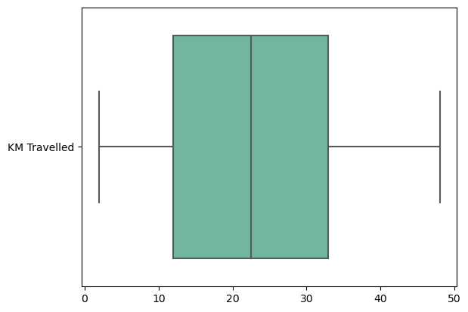
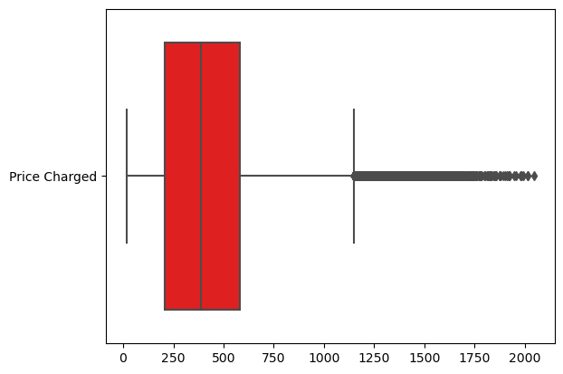
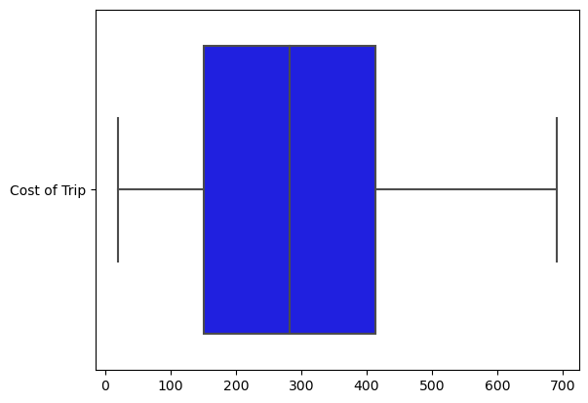
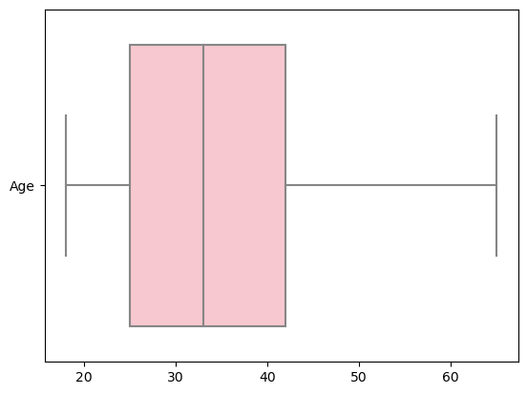
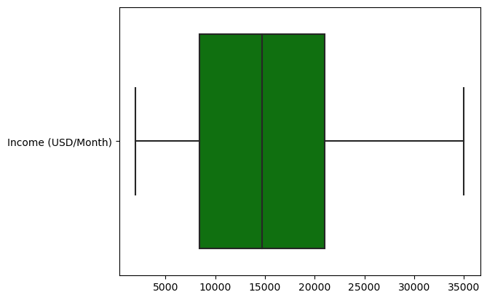
Checking for Outliers
We can see that most of the variables for the data don’t have outliers.
It is reasonable to assume for the analysis that most of the data is normally distributed.
All of this is true except for the Price Charged variable which has a ton of outliers. Thus the price charged does go all the way into the $2000 dollar range. However, since we don’t know the full details of how long each trip was, I won’t be treating them as outliers.

Slide 7
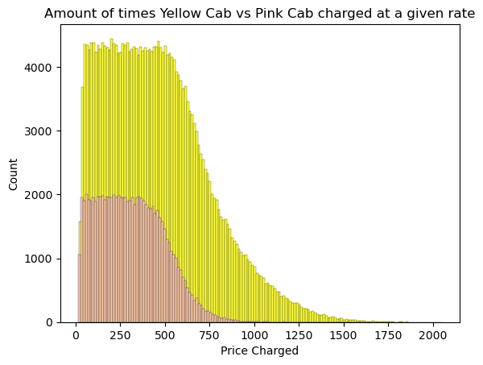
We can see from the graph to the right that not only does yellow have more volume of transactions, but also they charge higher rates to people.
This is important for our analysis since it means that yellow overall recorded better transactions than pink did. Thus, pink had a lot of NA values for their data which makes it unreliable for analysis.
Yellow already seems like the better company due to their volume of data alone, but lets break down the Profit between each company.

Slide 8
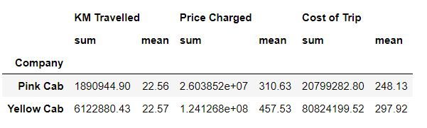
Analysis (Per Company)
To calculate the profit of each company we need to first look at what each company is doing in terms of their Kilometers travelled, price charged, and cost of trip.
We can see that Yellow Cab on average is travelling around the same amount of Kilometers but charging more and spending more per trip.
To calculate profit for this analysis, I used the formula below:
Profit = Sum of Price Charged – Sum of Cost of Trip

Slide 9
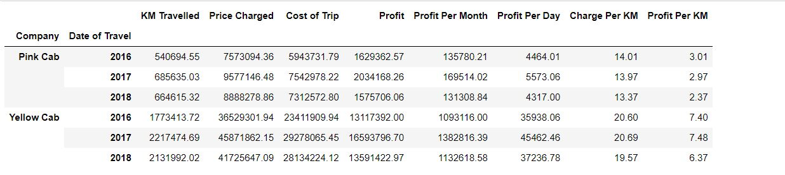
Profit Analysis (Yearly)
Yearly analysis shows below that the profit per year is drastically different between each company with the Yellow Cab company profiting 10x the amount that Pink Cab makes. 2017 was the best year for both companies making an extra 25% of their annual income from the previous year.
We can also see that for each KM travelled Yellow Cab Company is making 3 times the Profit per KM for Pink Cab Company. These numbers are staggering as Pink Cab only 1-2 million dollars in profit per year while Yellow makes 13-16 million. Next, let’s break this down by quarter.

Slide 10
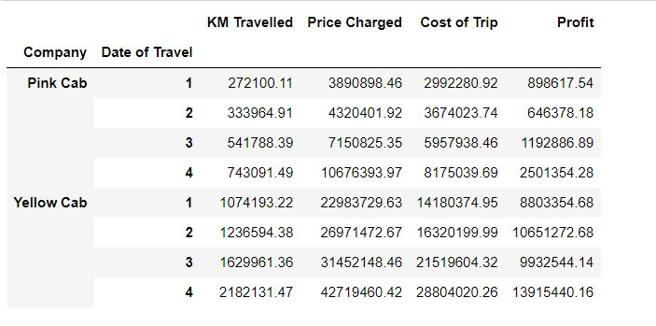
Profit Analysis (Quarterly)
For each quarter we can see that each companies profit is different.
Yellow Cab company tends to do better in quarters 2 and 4 while Pink Cab company tends to make more profit in quarters 3 and 4.
This means that Yellow Cab is probably located in cities where intense weather occurs while Pink Cab has a tendency to do well in colder months.

Slide 11
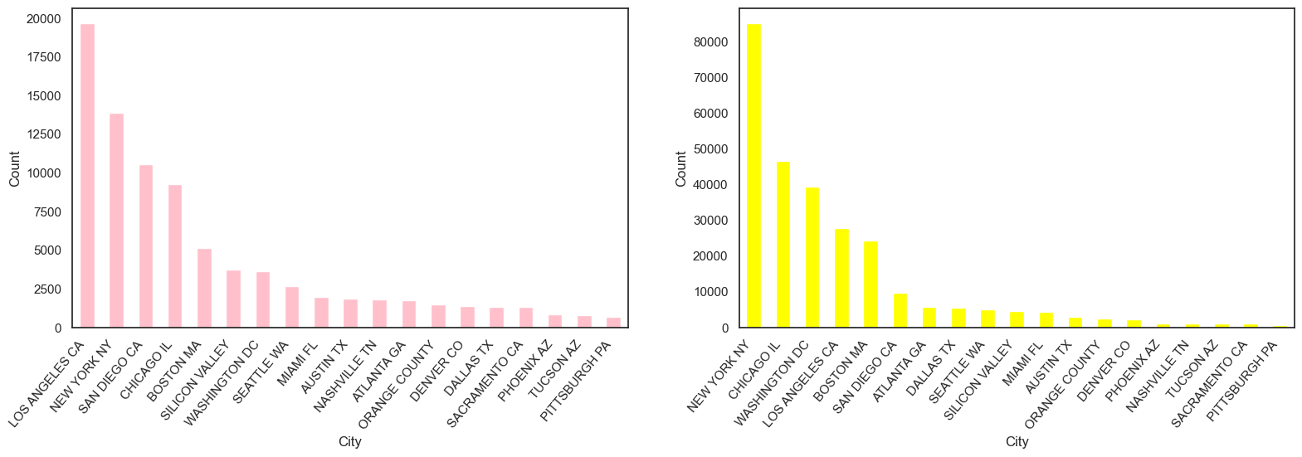
City Analysis
Here is the City breakdown of our data. Yellow cab does the best in New York City with over 80000 transactions while Pink Cab did the best in Los Angeles with approximately 20000 observations. Thus, Yellow Cab tends to gain the most data and profit in New York compared to most other cities.

Slide 12
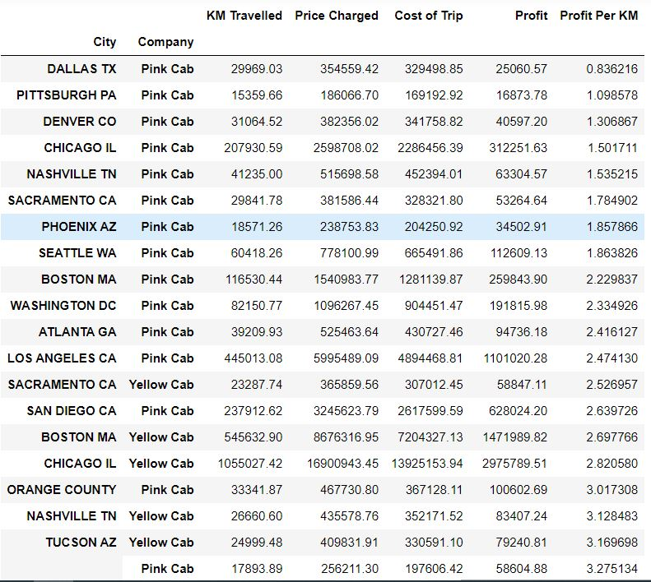
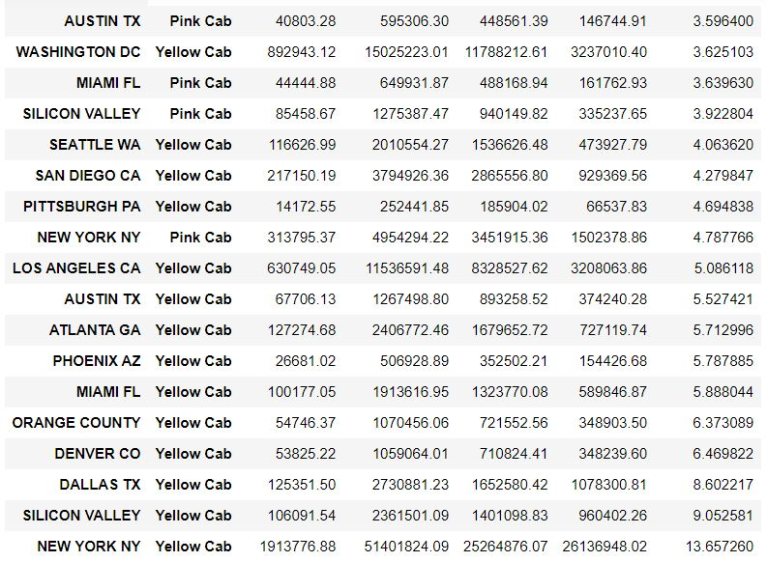
Profit Analysis (by City)

Slide 13
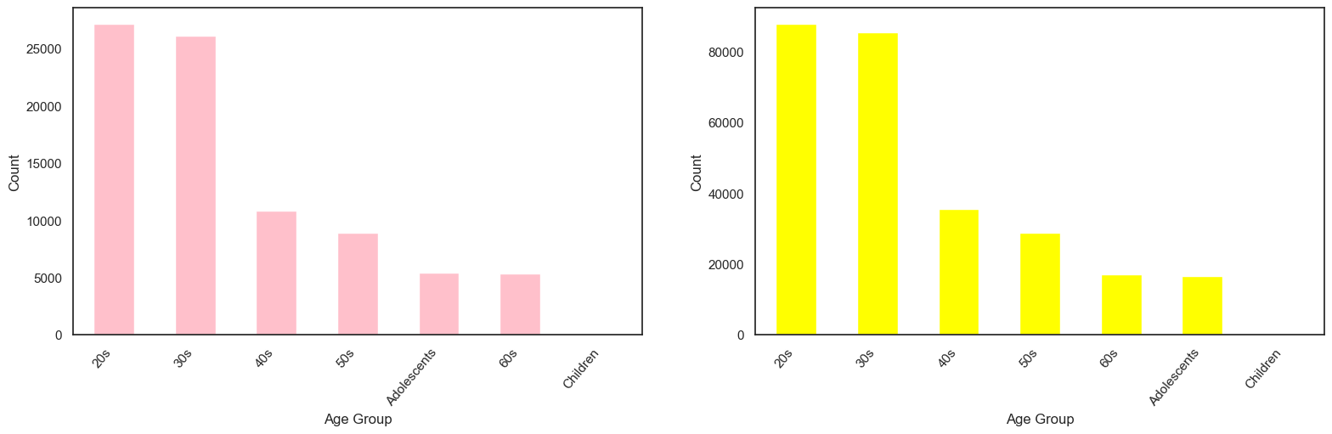
Age
Finally, there seems to be a trend in the way younger people are taking Ubers to get around.
But is that true?
Taking a look at the graph below, we can see that people in their 20s and 30s are spending the most of cab rides for both companies. New York, for example, is not a place that tends to have older people due to it not being a great place for retirement.

Slide 14
Recommendations
After looking at the numbers and graphs, we believe that Yellow Cab would be a better investment for a couple of reasons:
Locations: Not only does Yellow Cab company have more locations that they operate in, but also they tend to dominate in those markets.
Quarterly Profit: Due to their location base, Yellow cab tends to do better in quarters 2 and 4. Since they dominate the New York market and since it gets hot and cold in the summer and winter months, people tend to take cabs more to get out of the cold which results in more money.
Yearly Profit: Yellow Cab within the two years made around 42 million dollars while Pink Cab only made 5 million.
Volume: Yellow Cab not only has more volume, but charges more per transaction than Pink Cab does.
Age Group: Yellow Cab just like Pink Cab appeals to younger audiences more than older audiences, but for people in their 20s Yellow cab made 80000 transactions while Pink Cab only made 20000 transactions for the two years.
Kilometers travelled and Price Charged: Both companies on average are travelling the same distance, but Yellow Cab is making more profit by charging more.
Thus, we believe that Yellow Cab Company would be the best company to invest in for the future.

Slide 15
Thank You

